Slide 1
Modularity in Large Proofs
Georges Gonthier
Inria

Slide 2
Modularity in Large Proofs
What’s in a proof?
Background theories
  From pencil-and-paper to algebra to exceptional characters
    Multiple usage, “small” interface
    Pareto size / use distribution
    See morning
Explicit argument
  String of lemmas, tactics
    Bespoke results, larger interface
    How much structure?
    Which structure?

Slide 3
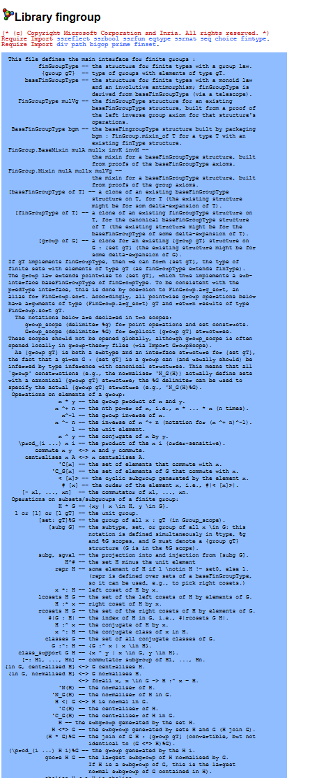
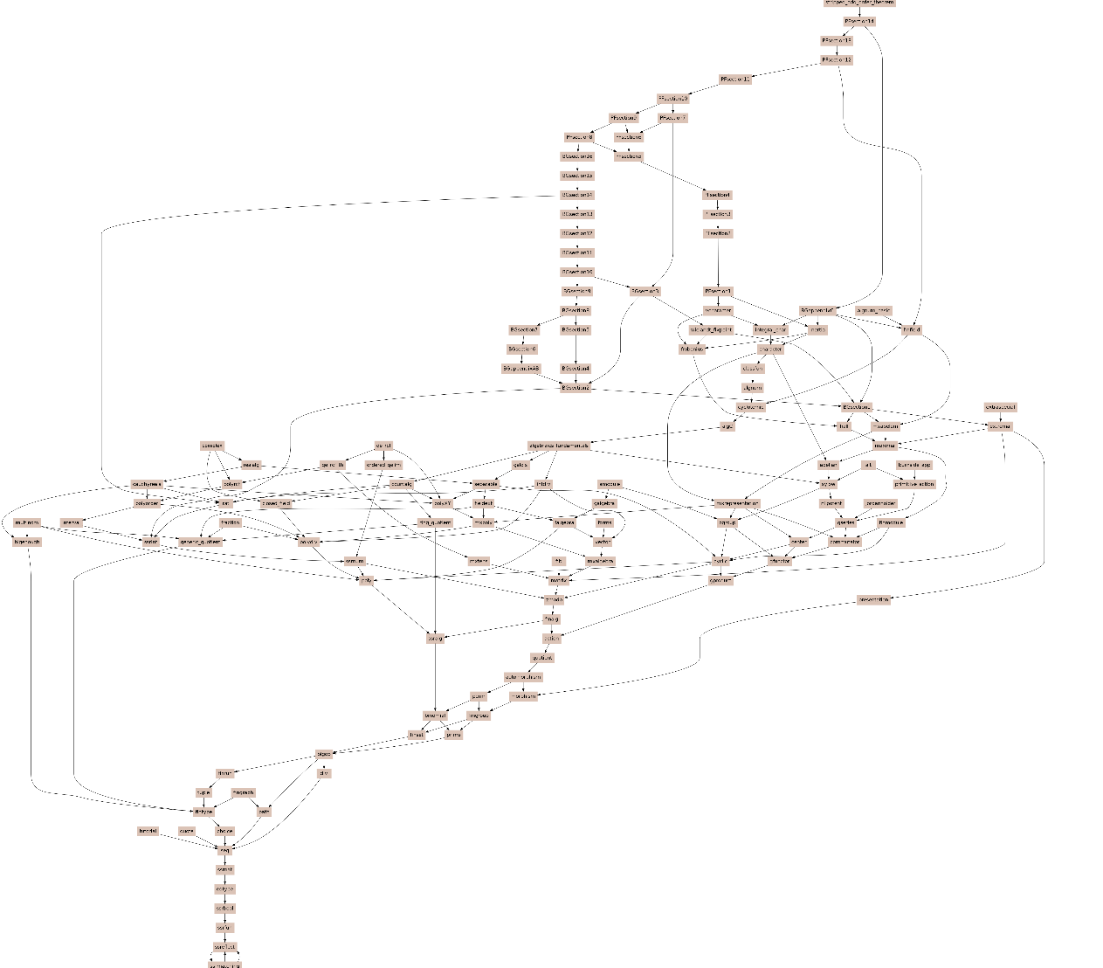
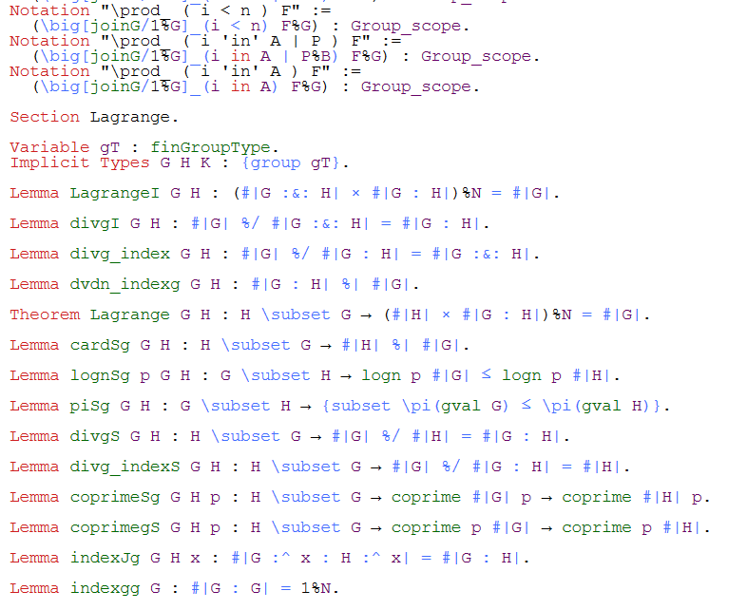

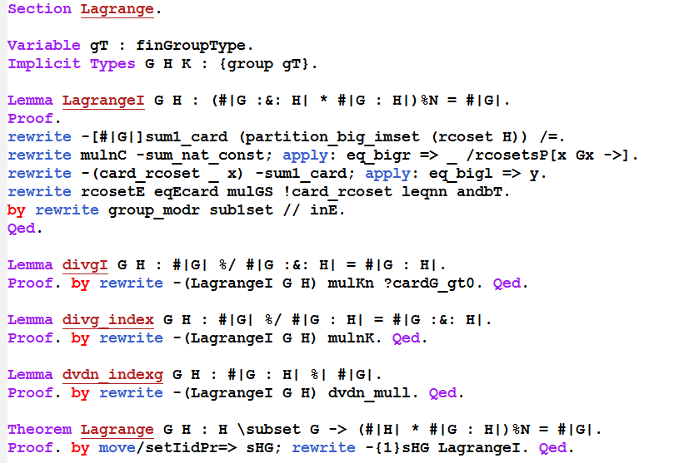
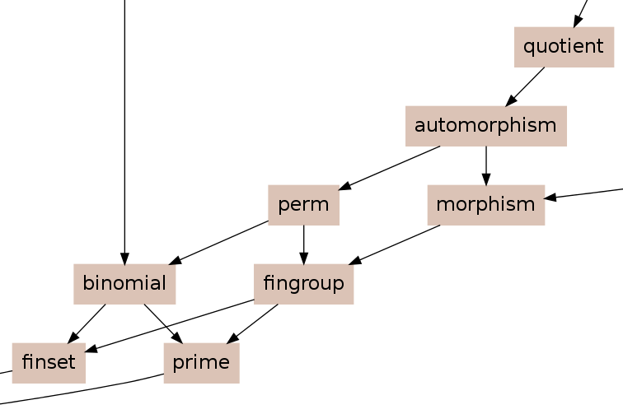
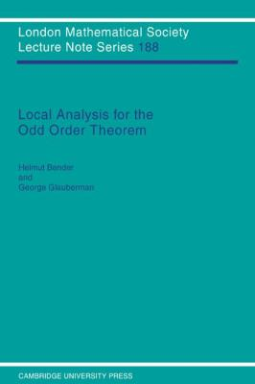
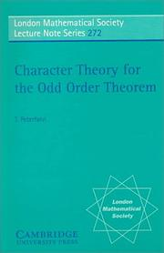
Background Libraries
Feit Thompson
components
4 colour

Slide 4
Power law

Slide 5
Ancient mathematics

Slide 6
Modern Mathematics

Slide 7
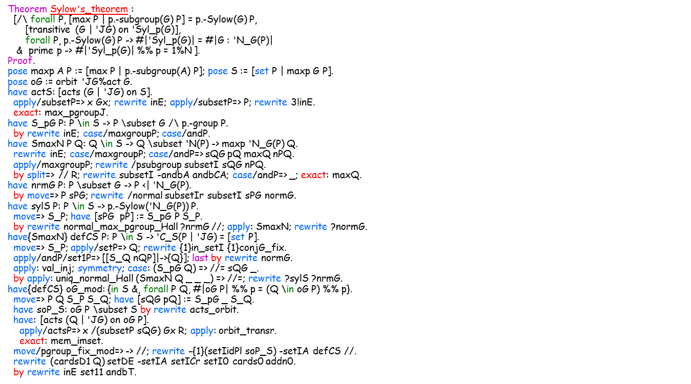
Computer Mathematics

Slide 8
Evolution ?
Theorem Sylow's_theorem :
[/\ forall P, [max P | p.-subgroup(G) P] = p.-Sylow(G) P,
[transitive (G | 'JG) on 'Syl_p(G)],
forall P, p.-Sylow(G) P -> #|'Syl_p(G)| = #|G : 'N_G(P)|
& prime p -> #|'Syl_p(G)| %% p = 1%N ].
Proof.
pose maxp A P := [max P | p.-subgroup(A) P]; pose S := [set P | maxp G P].
pose oG := orbit 'JG%act G.
have actS: [acts (G | 'JG) on S].
apply/subsetP=> x Gx; rewrite inE; apply/subsetP=> P; rewrite 3!inE.
exact: max_pgroupJ.
have S_pG P: P \in S -> P \subset G /\ p.-group P.
by rewrite inE; case/maxgroupP; case/andP.
have SmaxN P Q: Q \in S -> Q \subset 'N(P) -> maxp 'N_G(P) Q.
rewrite inE; case/maxgroupP; case/andP=> sQG pQ maxQ nPQ.
apply/maxgroupP; rewrite /psubgroup subsetI sQG nPQ.
by split=> // R; rewrite subsetI -andbA andbCA; case/andP=> _; exact: maxQ.
have nrmG P: P \subset G -> P <| 'N_G(P).
by move=> P sPG; rewrite /normal subsetIr subsetI sPG normG.
have sylS P: P \in S -> p.-Sylow('N_G(P)) P.
move=> S_P; have [sPG pP] := S_pG P S_P.
by rewrite normal_max_pgroup_Hall ?nrmG //; apply: SmaxN; rewrite ?normG.
have{SmaxN} defCS P: P \in S -> 'C_S(P | 'JG) = [set P].
move=> S_P; apply/setP=> Q; rewrite {1}in_setI {1}conjG_fix.
apply/andP/set1P=> [[S_Q nQP]|->{Q}]; last by rewrite normG.
apply: val_inj; symmetry; case: (S_pG Q) => //= sQG _.
by apply: uniq_normal_Hall (SmaxN Q _ _ _) => //=; rewrite ?sylS ?nrmG.
have{defCS} oG_mod: {in S &, forall P Q, #|oG P| %% p = (Q \in oG P) %% p}.
move=> P Q S_P S_Q; have [sQG pQ] := S_pG _ S_Q.
have soP_S: oG P \subset S by rewrite acts_orbit.
have: [acts (Q | 'JG) on oG P].
apply/actsP=> x /(subsetP sQG) Gx R; apply: orbit_transr.
exact: mem_imset.
move/pgroup_fix_mod=> -> //; rewrite -{1}(setIidPl soP_S) -setIA defCS //.
rewrite (cardsD1 Q) setDE -setIA setICr setI0 cards0 addn0.
by rewrite inE set11 andbT.
Isabelle

Slide 9
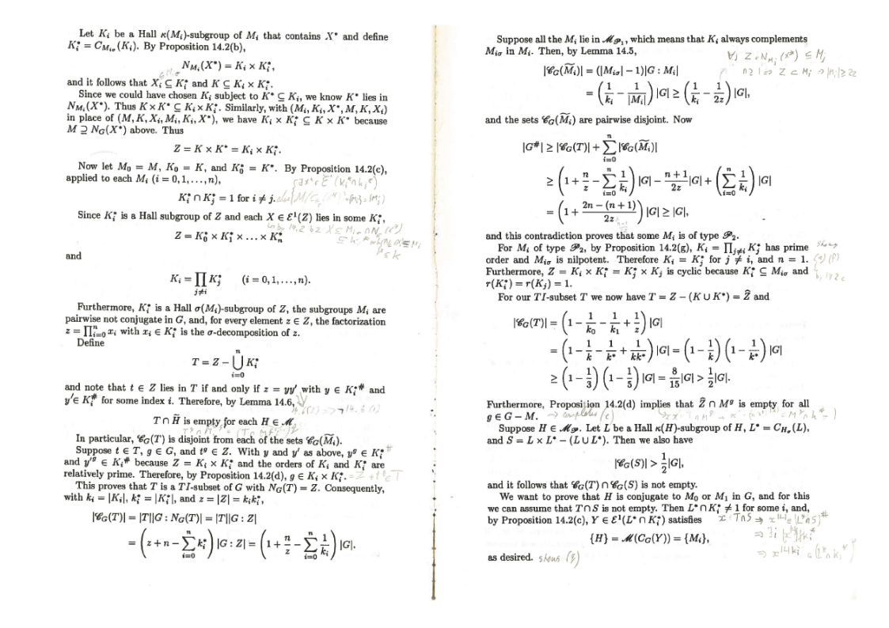
Textbook Mathematics

Slide 10
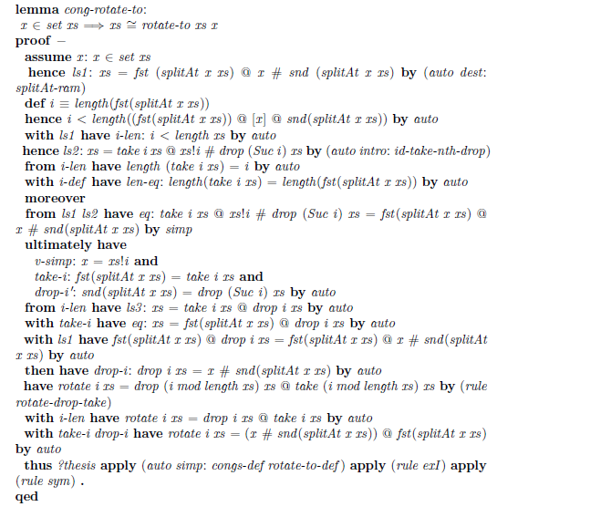
Declarative (Isar)

Slide 11
Declarative (Mizar)
A9: for s being real number st s in X holds s<=k/D
proof
let s be real number;
assume s in X;
then consider x being set such that
B1: x in dom abs f and
B2: s = (abs f).x by FUNCT_1:def 5;
B3: s = abs(f.x) by B1,B2,SEQ_1:def 10;
reconsider x as Element of REAL by B1;
set A = f.(x+y), B = f.(x-y), C = abs(f.x);
B4: abs(A+B)<=abs(A)+abs(B) by COMPLEX1:142;
abs(A) in X & abs(B) in X by Lm1;
then abs(A)<=k & abs(B)<=k by A6,SEQ_4:def 4;
then
B5: abs(A)+abs(B)<=k+k by XREAL_1:9;
abs(A+B) = abs(2*f.x*g.y) by A1
.= abs(2*f.x)*D by COMPLEX1:151
.= abs(2)*C*D by COMPLEX1:151
.= 2*C*D by ABSVALUE:def 1;
then 2*(C*D)<=2*k by B4,B5,XREAL_1:2;
then C*D<=k by XREAL_1:70;
then C*D/D<=k/D by A5,XREAL_1:74;
hence thesis by A5,B3,XCMPLX_1:90;
end;
abs(f.z) in X by Lm1;
then
B6: abs(f.z)<=k by A6,SEQ_4:def 4;
0<abs(f.z) by A2,COMPLEX1:133;
then 0<k by B6,XREAL_1:2;
then k/D<k/1 by A4,XREAL_1:78;
hence thesis by A9,SEQ_4:62;
end;
theorem
(for x,y holds f.(x+y)+f.(x-y)=2*f.x*g.y) &
(ex x st f.x<>0) & (for x holds abs(f.x)<=1)
implies for x holds abs(g.x)<=1
proof
assume that
A1: for x,y holds f.(x+y)+f.(x-y)=2*f.x*g.y;
given z such that
A2: f.z<>0;
assume
A3: for x being Element of REAL holds abs(f.x)<=1;
let y such that
A4: abs(g.y) > 1;
set X = rng abs f, k = upper_bound X, D = abs(g.y);
A5: abs(g.y) > 0 by A4,XREAL_1:2;
A6: X is bounded_above
proof
take 1;
let r be real number;
assume r in X;
then consider x being set such that
A7: x in dom abs f and
A8: (abs f).x = r by FUNCT_1:def 5;
abs(f.x) = r by A7,A8,SEQ_1:def 10;
hence r<=1 by A3,A7;
end;

Slide 12
Imperative (Hol-light)
let IMO = prove
(`!f g. (!x y. f(x + y) + f(x - y) = &2 * f(x) * g(y)) /\
~(!x. f(x) = &0) /\
(!x. abs(f(x)) <= &1)
==> !x. abs(g(x)) <= &1`,
let LL = REAL_ARITH `&1 < k ==> &0 < k` in
REPEAT STRIP_TAC THEN SPEC_TAC(`x:real`,`y:real`) THEN
ABBREV_TAC `k = sup (IMAGE (\x. abs(f(x))) (:real))` THEN
MP_TAC(SPEC `IMAGE (\x. abs(f(x))) (:real)` SUP) THEN
ASM_SIMP_TAC[FORALL_IN_IMAGE; EXISTS_IN_IMAGE; IN_UNIV] THEN
ANTS_TAC THENL [ASM SET_TAC[]; STRIP_TAC] THEN
SIMP_TAC[GSYM REAL_NOT_LT; GSYM NOT_EXISTS_THM] THEN STRIP_TAC THEN
FIRST_X_ASSUM(MP_TAC o SPEC `k / abs(g(y:real))`) THEN
SIMP_TAC[NOT_IMP; NOT_FORALL_THM] THEN CONJ_TAC THENL
[ASM_MESON_TAC[REAL_LE_RDIV_EQ; REAL_ABS_MUL; LL;
REAL_ARITH `u + v = &2 * z /\ abs u <= k /\ abs v <= k ==> abs z <= k`];
ASM_MESON_TAC[REAL_NOT_LE; REAL_LT_LDIV_EQ; REAL_LT_LMUL; REAL_MUL_RID; LL;
REAL_ARITH `~(z = &0) /\ abs z <= k ==> &0 < k`]]);;

Slide 13
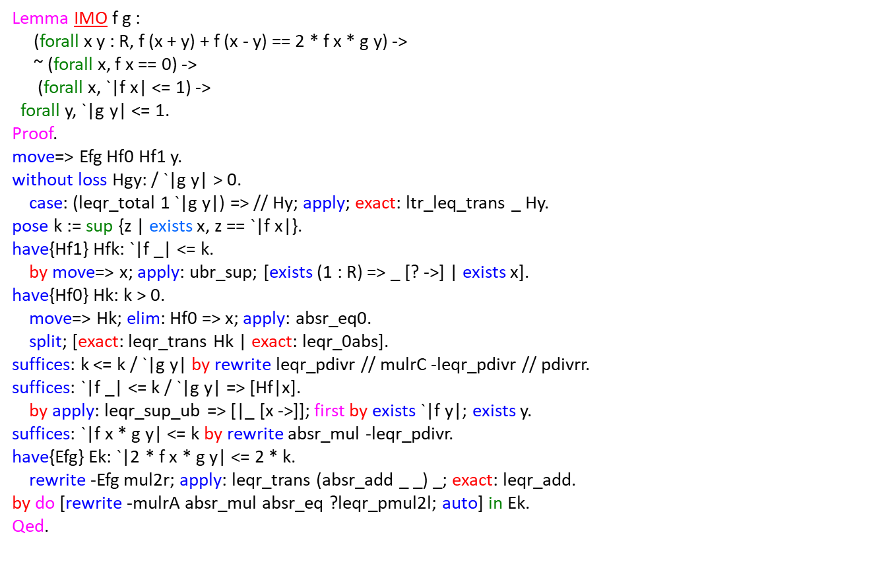
Structured (ssreflect)

Slide 14
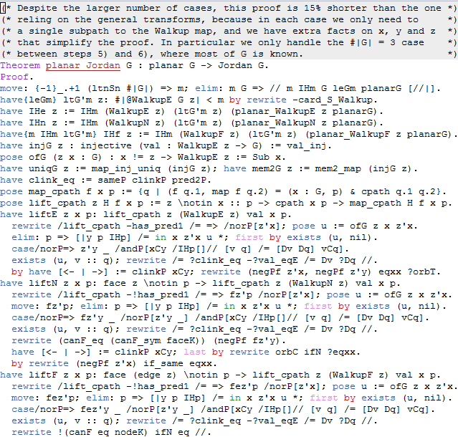
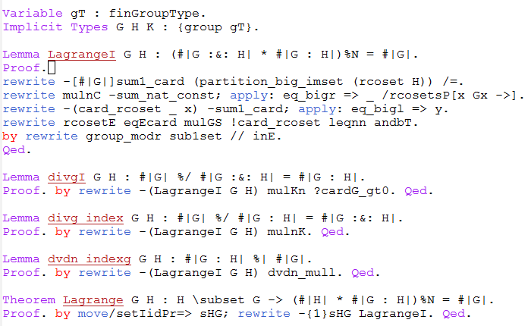
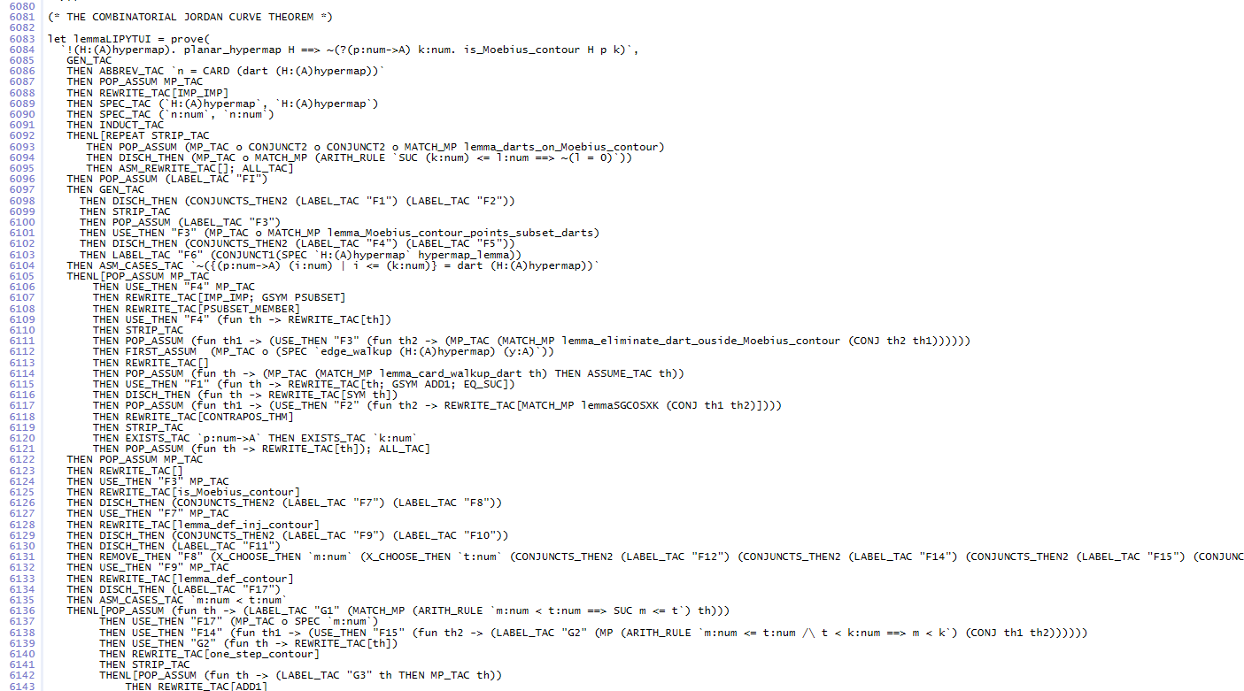
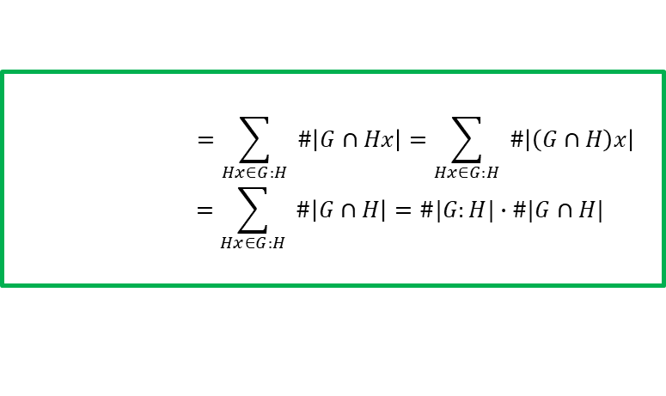
Size matters
117 lines
Mizar: 15 line statement
200 line proof
600+ lines proof
1000+ lines technical lemmas
$$=\sum_{Hx∈G:H}{ \#\left|G∩Hx\right|}=\sum_{Hx∈G:H}{ \#\left|\left(G∩H\right)x\right|}$$
$$=\sum_{Hx∈G:H}{ \#\left|G∩H\right|}=\#|G:H|∙\#|G∩H|$$

Slide 15
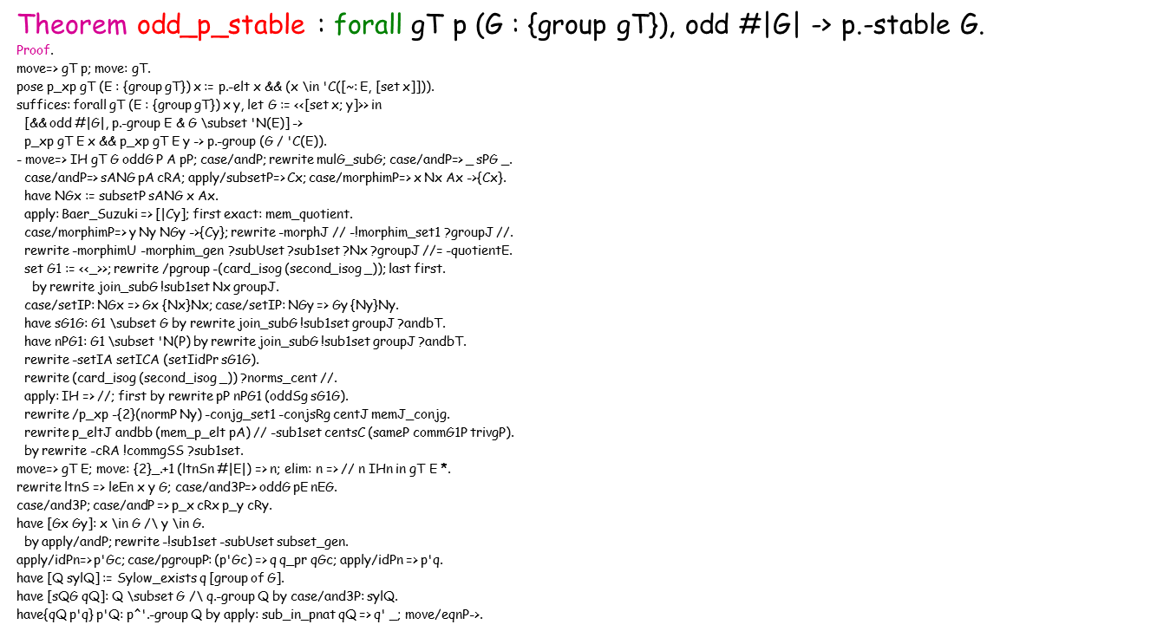
Organising large proofs
have abelE: p.-abelem E.
by rewrite -is_abelem_pgroup //; case: (minnormal_solvable minE_EG _ solE).
have cEE: abelian E by case/and3P: abelE.
have{minE_EG} minE: minnormal E G.
case/mingroupP: minE_EG => _ minE; apply/mingroupP; rewrite ntE.
split=> // D ntD sDE; apply: minE => //; rewrite join_subG cents_norm //.
by rewrite centsC (subset_trans sDE).
have nCG: G \subset 'N('C_G(E)) by rewrite normsI ?normG ?norms_cent.
suffices{p'Gc} pG'c: p.-group (G / 'C_G(E))^`(1).
have [Pc sylPc sGc'Pc]:= Sylow_superset (der_subS _ _) pG'c.
have nsPc: Pc <| G / 'C_G(E) by rewrite sub_der1_normal ?(pHall_sub sylPc).
case/negP: p'Gc; rewrite /pgroup -(card_isog (second_isog _)) ?norms_cent //.
rewrite setIC; apply: pgroupS (pHall_pgroup sylPc) => /=.
rewrite sub_quotient_pre // join_subG !sub1set !(subsetP nCG, inE) //=.
by rewrite !(mem_normal_Hall sylPc) ?mem_quotient ?morph_p_elt ?(subsetP nCG).
have defC := rker_abelem abelE ntE nEG; rewrite /= -/G in defC.
set rG := abelem_repr _ _ _ in defC.
case ncxy: (rG x *m rG y == rG y *m rG x).
have Cxy: [~ x, y] \in 'C_G(E).
rewrite -defC inE groupR //= !repr_mxM ?groupM ?groupV // mul1mx -/rG.
by rewrite (eqP ncxy) -!repr_mxM ?groupM ?groupV // mulKg mulVg repr_mx1.
rewrite [_^`(1)](commG1P _) ?pgroup1 //= quotient_gen -gen_subG //= -/G.
rewrite !gen_subG centsC gen_subG quotient_cents2r ?gen_subG //= -/G.
rewrite /commg_set imset2Ul !imset2_set1l !imsetU !imset_set1.
by rewrite !subUset andbC !sub1set !commgg group1 /= -invg_comm groupV Cxy.
pose Ax : 'M(E) := rG x - 1; pose Ay : 'M(E) := rG y - 1.
have Ax2: Ax *m Ax = 0.
apply/row_matrixP=> i; apply/eqP; rewrite row_mul mulmx_subr mulmx1.
rewrite row0 subr_eq0 -(inj_eq (@rVabelem_inj _ _ _ abelE ntE)).
rewrite rVabelemJ // conjgE -(centP cRx) ?mulKg //.
rewrite linear_sub /= addrC row1 rowE rVabelemD rVabelemN rVabelemJ //=.
by rewrite mem_commg ?set11 ?mem_rVabelem.
have{q q_pr sylQ qGc} ncEQ: ~~ (Q \subset 'C(E)).
apply: contraL qGc => cEQ; rewrite -p'natE // -partn_eq1 //.
have nCQ: Q \subset 'N('C(E)) by exact: subset_trans (normG _).
have sylQc: q.-Sylow(G / 'C(E)) (Q / 'C(E)) by rewrite morphim_pSylow.
by rewrite -(card_Hall sylQc) -trivg_card1 (sameP eqP trivgP) quotient_sub1.
have solE: solvable E := pgroup_sol pE.
have ntE: E :!=: 1 by apply: contra ncEQ; move/eqP->; rewrite cents1.
have{Q ncEQ p'Q sQG} minE_EG: minnormal E (E <*> G).
apply/mingroupP; split=> [|D]; rewrite join_subG ?ntE ?normG //.
case/and3P=> ntD nDE nDG sDE; have nDGi := subsetP nDG.
apply/eqP; rewrite eqEcard sDE leqNgt; apply: contra ncEQ => ltDE.
have nDQ: Q \subset 'N(D) by rewrite (subset_trans sQG).
have cDQ: Q \subset 'C(D).
have{q q_pr sylQ qGc} ncEQ: ~~ (Q \subset 'C(E)).
apply: contraL qGc => cEQ; …
have nCQ: Q \subset 'N('C(E)) by …
have sylQc: q.-Sylow(G / 'C(E)) (Q / 'C(E)) by…
by…
have solE: solvable E …
have ntE: E :!=: 1 by…
have{Q ncEQ p'Q sQG} minE_EG: minnormal E (E <*> G).
apply/mingroupP; split…
case/and3P=> ntD nDE nDG sDE…
…apply: contra ncEQ => ltDE.
have nDQ: Q \subset 'N(D) by…
have cDQ: Q \subset 'C(D).

Slide 16
Inequality chains
Longest proof: coherence for “nice” type P.
(* This is step (9.11.1). *) clear nS IHnS leS3nS.
without loss [[eqS12 irrS1 H0C_S1] [Da_p defC] [S3qu ne_qa_qu] [oS1 oS1ua]]:
/ [/\ [/\ S1 =i S2, {subset S1 <= irr M} & {subset S1 <= S_ H0C}],
a = p.-1./2 /\ C :=: U',
(forall chi, chi \in S3 -> chi 1%g == (q * u)%:R) /\ (q * u != q * a)%N
& size S1 = (p.-1 * u %/ a ^ 2)%N /\ size S1 = (2 * u %/ a)%N].
(* We'll show lb0 <= lb1 <= lb <= lb3 <= sumnS S1' <= sumnS S2 <= lb0, *)
(* with equality under conditions that imply the conclusion of (9.11.1). *)
pose lb0 := (2 * q * a)%:R * chi 1%g.
pose lb1 : algC := (2 * a * q ^ 2 * u)%:R.
pose lb2 : algC := (p.-1 * q ^ 2 * u)%:R.
pose lb3 : algC := (p.-1 * q ^ 2 * #|U : U'|)%:R.
pose S1' := filter [predI irr M & S_ H0U'] S1.
pose szS1' := ((p.-1 * #|U : U'|) %/ a ^ 2)%N; set lbS1' := _ %/ _ in lb_Sqa.
pose Snorm (psi : 'CF(M)) := psi 1%g ^+ 2 / '[psi].
pose sumnS Si := \sum_(psi <- Si) Snorm psi.
have lb01: lb0 <= lb1 ?= iff (chi 1%g == (q * u)%:R).
have lb12: lb1 <= lb2 ?= iff (a == p.-1./2).
have lb23: lb2 <= lb3 ?= iff (C :==: U') :> algC.
have lb3S1': lb3 <= sumnS S1' ?= iff (size S1' == szS1').
have lbS1'2: sumnS S1' <= sumnS S2 ?= iff ~~ has [predC S1'] S2.
have [lb0S2 | ] := boolP (lb0 < sumnS S2).
have lb1S2 := lerif_trans lb12 (lerif_trans lb23 (lerif_trans lb3S1' lbS1'2)).
rewrite ltr_neqAle !(lerif_trans lb01 lb1S2) andbT has_predC !negbK.
case/and5P=> /eqP chi1qu /eqP Da_p /eqP defC /eqP sz_S1' /allP sS21'.

Slide 17
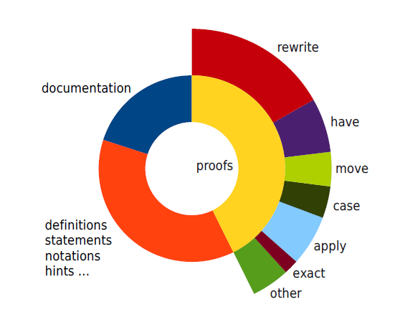
Tactics Statistics

